Slide 1
Bank of Sanky
By:- Sankalp Dekate

Slide 2
Contents
Introduction to Mobile Application Development
Mobile Banking
Bank of Sanky
Login Page
Main Menu
Checking Account
Saving Account
Transfer Account
Programming
Security Implementations
Advantages
Conclusion

Slide 3
Mobile Application Development
Mobile app development is the creation of software intended to run on mobile devices and optimized to take advantage of those product's unique features and hardware
With the exploding popularity of smartphones and tablets, mobile application development is becoming an increasingly popular medium of software creation.

Slide 4


Mobile Banking
Mobile Banking(MB) is an application that lives on mobile phone, which access and manipulates their bank account at anytime and anywhere
MB is system that allows customers to perform a number of financial transactions through mobile device
Monitoring our Bank accounts through the Mobiles, is know as Mobile Banking

Slide 5
Bank of Sanky
Bank of Sanky is a Mobile Banking android app for bank transaction
Bank of Sanky app allows a customer to log in to his account
check his current checking and savings balance
deposit or withdraw money from both accounts
transfer funds from one account to another

Slide 6
Bank of Sanky
Customer must provide a valid username and password to log into his accounts
Upon successful login, the customer is redirected to the menu screen where he can choose to proceed to Checking Account, Savings Account or Transfer Funds screens

Slide 7

Bank of Sanky
Checking and Savings screens enable the user to see his current checking or savings balance and deposit or withdraw money from his checking or savings account
Transfer screen enables the user to choose between transferring money from checking to a savings account or vice versa.

Slide 8

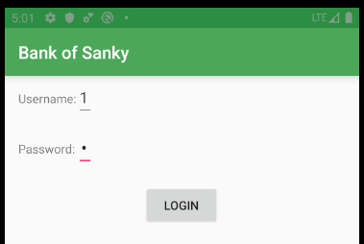


Login Page

Slide 9
Login Page
As soon as you log in the app, the above login page will be displayed
We need to enter our login credentials to view our account
The authenticity while logging should be maintained
There should be no leakage of your private data at any time

Slide 10
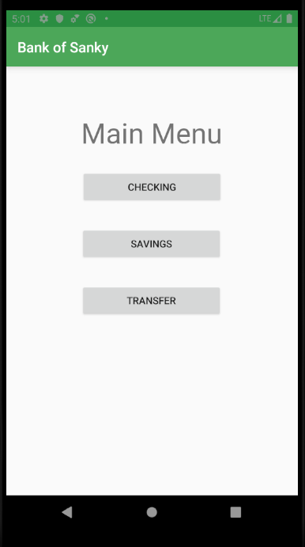
Main Menu

Slide 11
Main Menu
As soon as you enter your credentials the app will take you to the main menu
There will be 3 main options in the menu.
The 3 options are as follows:
Checking
Saving
Transfer

Slide 12
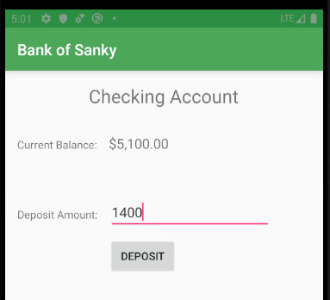
Checking Account
Here we can see an example of checking account in the Bank of Sanky app
Here we get option to deposit amount
Amount can be deposited from the Current Balance

Slide 13
What is Checking Account?
an account at a bank against which checks can be drawn by the account depositor
A checking account is a deposit account held at a financial institution that allows withdrawals and deposits
Also called demand accounts or transactional accounts, checking accounts are very liquid and can be accessed using checks
automated teller machines, and electronic debits, among other methods

Slide 14
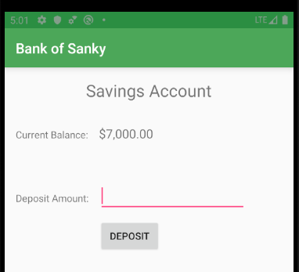
Saving Account
Here we can see an example of saving account in the Bank of Sanky app
Here we get option to deposit amount in the saving account and later check the balance
Amount can be checked at any time

Slide 15

What is Saving Account?
a bank account that earns interest
A savings account is a bank account where you store money and earn interest on that money
You're earning interest because the bank is using your funds to loan money to other people

Slide 16
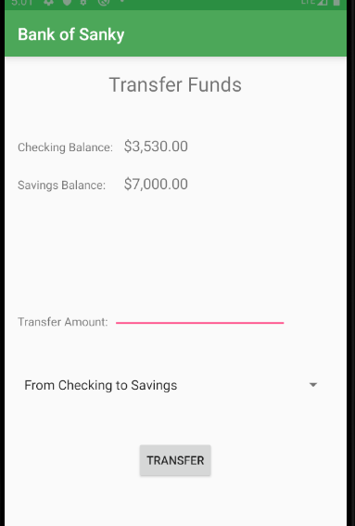
Transfer Account
Here we can see an example of saving account in the Bank of Sanky app
Here we get option to transfer amount
Either we can transfer amount from Checking to Savings
Or we can transfer amount from Savings account to Checking Account

Slide 17
Transfer Account
A linked transfer account is when accounts held by an individual at a financial institution are connected to each other in order to enable the transfer of funds to and from each other
The most common linked transfer accounts are from savings accounts to checking accounts or credit card accounts

Slide 18
Programming
Each screen uses a java class to handle the programming logic. Java classes include all necessary conditions to check the validity of transactions
For example, the user can’t withdraw more money than it’s available in the account

Slide 19
Bank of Sanky
Bank of Sanky app keeps track of customer’s balance by utilizing Android Shared Preferences file
Each time the user makes a transaction, shared preferences file is updated
When the user quits the application and logs in again, his previous balances are retrieved from shared preferences file

Slide 20
Security Implementation
Bank of Sanky app security is implemented by requiring a customer to provide valid username and password
After three unsuccessful logins, the application shuts down
When a transaction will done, then authorized customer will receive an alert message
If customer lost their Mobile, they can call to bank to block their channel or card
Bank of Sanky app is created with Android Studio to run on all Android phones

Slide 21
Advantages
Simple and Easy to use
Menu based Application Program
Transmitted data are secured
Almost every android phone with minimum specifications can support this app
No need to go for Bank Branch
Handle all types of transaction from anywhere at anytime

Slide 22
Conclusion
We can conclude that Bank of Sanky is one of the best mobile banking android in today’s world
Firstly, we need to create account with valid and authentic login credentials
Secondly, after setting up account we need to deposit money to perform some transfer activities
There are 3 types of account namely: Checking, Saving and Transfer

Slide 23
Conclusion
We can transfer funds in one of the two ways:
Either from Checking to Saving account
Or from Saving to Checking account
Each screen uses a java class to handle the programming logic
Java classes include all necessary conditions to check the validity of transactions
Bank of Sanky app is created with Android Studio to run on all Android phones

Slide 24
Thank You

